Slide 1
COMPUTER SCIENCE AND ENGINEERING
Presentation Material
Department of Computer Science & Engineering
Course Code: | 19CS3602 | Semester: | VI
Course Title: | COMPUTER NETWORK | Year:20212022

Slide 2
MODULE 1
OVERVIEW OF THE INTERNET
Protocol, layering scenario, TCP/IP Protocol model, Internet history standards and administration, Comparison of the OSI reference model
Physical layer: Introduction to Guided transmission media and wireless transmission media, Transmission mode, Classification of networks, Parallel and serial Transmissions, Analog & Digital signals, Periodic & aperiodic signals, encoding schemes, RS-233C Protocol.
Datalink layer: Design issues, CRC codes, Elementary data link layer protocols, stop and wait, sliding window, go-back-N protocols

Slide 3
Network Models
PROTOCOL LAYERING
Protocol defines the rules that both the sender and receiver and all intermediate devices need to follow to be able to communicate effectively.
When communication is simple- one simple protocol
When the communication is complex-need to divide the task between different layers, in which case we need a protocol at each layer, or protocol layering.

Slide 4
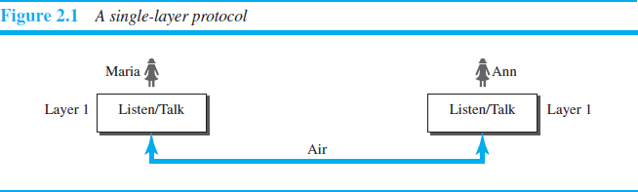
Scenarios
Let us develop two simple scenarios to better understand the need for
protocol layering.
First scenario
communication is so simple that it can occur in only one layer.
Assume Maria and Ann are neighbors with a lot of common ideas.
Communication between Maria and Ann takes place in
one layer, face to face, in the same language, as shown in Fig2.1.

Slide 5
Even in this simple scenario, we can see that a set of rules needs to be followed.
Maria and Ann know that they should greet each other when they meet.
They know that they should confine their vocabulary to the level of their friendship.
Each party knows that she should refrain from speaking when the other party is speaking.
Each party knows that the conversation should be a dialog, not a monolog: both should have the opportunity to talk about the issue.
They should exchange some nice words when they leave.
2.42

Slide 6
Second Scenario
Assume that Ann is offered a higher-level position in her company, but needs to move to another branch located in a city very far from Maria.
The two friends still want to continue their communication and exchange ideas because they have come up with an innovative project to start a new business when they both retire.
They decide to continue their conversation using regular mail through the post office.They do not want their ideas to be revealed by other people if the letters are intercepted. They agree on an encryption/decryption technique.

Slide 7
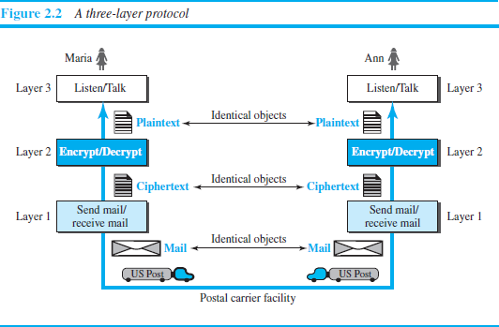
The sender of the letter encrypts it to make it unreadable by an intruder ;
the receiver of the letter decrypts it to get the original letter.
Now we can say that the communication between Maria and Ann
takes place in three layers, as shown in Figure 2.2.

Slide 8
Let us assume that Maria sends the first letter to Ann. At Maria s side:
Maria talks to the machine at the third layer as though the machine is Ann and is listening to her.
The third layer machine listens to what Maria says and creates the plaintext (a letter in English), which is passed to the second layer machine.
The second layer machine takes the plaintext, encrypts it, and creates the ciphertext, which is passed to the first layer machine.
The first layer machine, presumably a robot, takes the ciphertext ,puts it in an envelope, adds the sender and receiver addresses, and mails it.

Slide 9
At Ann’s side
The first layer machine picks up the letter from Ann’s mail box,
recognizing the letter from Maria by the sender address.
The machine takes out the ciphertext from the envelope and delivers it to the second layer machine.
The second layer machine decrypts the message creates the plaintext, and passes the plaintext to the third-layer machine.
The third layer machine takes the plaintext and reads it as though Maria is speaking.
Protocol layering enables us to divide a complex task into several smaller and simpler tasks.

Slide 10
For example, in Figure 2.2, we could have used only one machine to do the job of all three machines. However, if Maria and Ann decide that the encryption/ decryption done by the machine is not enough to protect their secrecy, they would have to change the whole machine.
In the present situation, they need to change only the second layer machine; the other two can remain the same. This is referred to as modularity.
Modularity in this case means independent layers.
A layer (module) can be defined as a black box with inputs and outputs, without concern about how inputs are changed to outputs.
If two machines provide the same outputs when given the same inputs,they can replace each other.

Slide 11
For example, Ann and Maria can buy the second layer machine from two different manufacturers. As long as the two machines create the same ciphertext from the same plaintext and vice versa, they do the job.
Advantages of protocol layering
Allows to separate the services from the implementation.
A layer needs to be able to receive a set of services from the lower layer and to give the services to the upper layer; we don’t care about how the layer is implemented.
For example, Maria may decide not to buy the machine (robot) for the first layer; she can do the job herself. As long as Maria can do the tasks provided by the first layer, in both directions, the communication system works.

Slide 12
Reduces the complexity at the intermediate system
Communication does not always use only two end systems; there areintermediate systems that need only some layers, but not all layers.
If we did not use protocol layering, we would have to make each intermediate system as complex as the end systems, which makes the whole system more expensive.
Two principles of protocol layering
First Principle
The first principle dictates that if we want bidirectional communication, we
need to make each layer so that it is able to perform two opposite tasks,
one in each direction.
For example, the third layer task is to listen (in one direction) and talk (in
the other direction). The second layer needs to be able to encrypt and decrypt. The first layer needs to send and receive mail.

Slide 13
Second Principle
The second principle that we need to follow in protocol layering is that the two objects under each layer at both sites should be identical.
For example, the object under layer 3 at both sites should be a
plaintext letter. The object under layer 2 at both sites should be a ciphertext letter. The object under layer 1 at both sites should be a piece of mail.
Logical Connections
Two protocols at the same layer can have a logical Connection
This means that we have layer-to-layer communication.

Slide 14
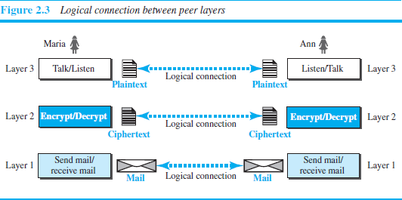
Maria and Ann can think that there is a logical (imaginary) connection at each layer through which they can send the object created from that layer.

Slide 15
TCP/IP PROTOCOL SUITE
TCP/IP(Transmission Control Protocol/Internet Protocol) is a protocol suite used in the Internet today.
It is a hierarchical protocol made up of interactive modules, each of which provides a specific functionality.
The term Hierarchical means that each upper level protocol is supported by one or more lowelevel
The original TCP/IP protocol suite was defined as four software layers built upon the hardware.
Today, however, TCP/IP is thought of as a five-layer model. Figure 2.4
shows both configurations.

Slide 16
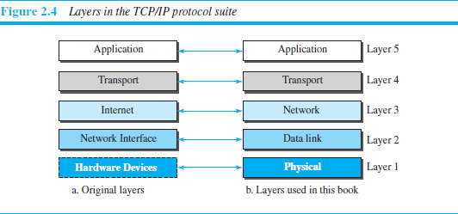
Layered Architecture
To show how the layers in the TCP/IP protocol suite are involved in communication between two hosts, we assume that we want to use the suite in a small internet made up of three LANs (links), each with a link- layer switch.
We also assume that the links are connected by one router

Slide 17
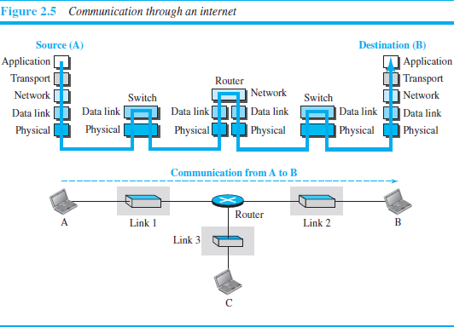

Slide 18
Let us assume that computer A communicates with computer B.
As the figure shows, we have five communicating devices in this
communication:
source host(computer A)
The link-layer switch in link 1
The router
The link-layer switch in link 2,
destination host (computer B).
Each device is involved with a set of layers depending on the role of the
device in the internet.
The two hosts are involved in all five layers
The source host needs to create a message in the application layer and send it down the layers so that it is physically sent to the destination host.
The destination host needs to receive the communication at the physical layer and then deliver it through the other layers to the application layer.

Slide 19
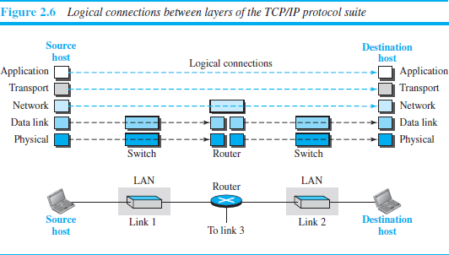
The router is involved in only three layers; link-layer switch in a link is involved only in two layers, data-link and physical.
Layers in the TCP/IP Protocol Suite
To better understand the duties of each layer, we need to think about the logical connections between layers.

Slide 20
The duty of the application, transport, and network layers is end-to-end.
The duty of the data-link and physical layers is hop-to-hop, in which a hop is a host or router.
The domain of duty of the top three layers is the internet, and the
domain of duty of the two lower layers is the link.
Another way of thinking of the logical connections is to think about the data unit created from each layer.
In the top three layers, the data unit (packets) should not be changed
by any router or link-layer switch.
In the bottom two layers, the packet created by the host is changed
only by the routers, not by the link-layer switches.

Slide 21
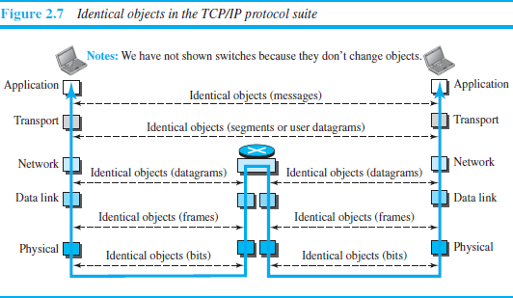
Figure 2.7 shows the second principle the identical objects at each layer related to each device.
Although the logical connection at the network layer is between the two hosts, we can only say that identical objects exist between two hops in this case because a router may fragment the packet at the network layer and send more packets than Received.

Slide 22
Description of Each Layer
The link between two hops does not change the object.
Physical Layer
The lowest level in the TCP/IP protocol suite, responsible for carrying individual bits in a frame across the link
Two devices are connected by a transmission medium (cable or air).
The transmission medium does not carry bits; it carries electrical or optical signals. So the bits received in a frame from the data-link layer are transformed and sent through the transmission media

Slide 23
Data-link Layer
Responsible for taking the datagram and moving it across the link.
Internet is made up of several links (LANs and WANs) connected by routers. There may be several overlapping sets of links that a datagram can travel from the host to the destination.
The routers are responsible for choosing the best links.when the next link to travel is determined by the router, the data-link layer is responsible for taking the datagram and moving it across the link.
The link can be a wired LAN with a link-layer switch, a wireless LAN, a
wired WAN, or a wireless WAN.
TCP/IP does not define any specific protocol for the data-link layer. It
supports all the standard and proprietary protocols.
The data-link layer takes a datagram and encapsulates it in a packet
called a frame.
Each link-layer protocol may provide a different service. Some link-layer protocols provide complete error detection and correction, some provide only error correction

Slide 24
Network Layer
responsible for creating a connection between the source computer
and the destination computer.
responsible for host-to-host communication and routing the packet
through possible routes.
The network layer in the Internet includes the main protocol, Internet
Protocol (IP),
defines the format of the packet, called a datagram at the
network layer.
defines the format and the structure of addresses used in this layer.
responsible for routing a packet from its source to its destination, which is achieved by each router forwarding the datagram to the next router in its path.
IP is a connectionless protocol that provides no flow control, no error control, and no congestion control services. This means that if any of theses services is required for an application, the application should rely only on the transport-layer protocol.

Slide 25
The network layer also includes unicast (one-to-one) and multicast
(one-to-many) routing protocols.
A routing protocol does not take part in but it creates forwarding tables
for routers to help them in the routing process.
The network layer also has some auxiliary protocols that help IP in its
delivery and routing tasks.
The Internet Control Message Protocol (ICMP)- helps IP to report
some problems when routing a packet.
The Internet Group Management Protocol (IGMP)-helps IP in
multitasking.
The Dynamic Host Configuration Protocol (DHCP)-helps IP to get the network-layer address for a host.
The Address Resolution Protocol (ARP)-IP to find the link-layer
address of a host or a router when its network-layer address is given.

Slide 26
Transport Layer
Responsible for giving services to the application layer: to get a message from an application program running on the source host encapsulates it in a transport layer packet (called a segment or a user datagram and deliver it to the corresponding application program on the destination host through the logical connection
The logical connection at the transport layer is also end-to-end.
There are a few transport-layer protocols in the Internet, each designed for some specific task.
Transmission Control Protocol (TCP)
connection-oriented protocol that first establishes a logical connection between transport layers at two hosts before transferring data.
creates a logical pipe between two TCPs for transferring a stream
of bytes.

Slide 27
provides flow control, error control and congestion
User Datagram Protocol (UDP)
connectionless protocol that transmits user datagrams without first
creating a logical connection
each user datagram is an independent entity without being related to
the previous or the next one
does not provide flow, error, or congestion control
simplicity, which means small overhead, is attractive to an application program that needs to send short messages and cannot afford the retransmission of the packets involved in TCP, when a packet is corrupted or lost.
Stream Control Transmission Protocol (SCTP)
designed to respond to new applications that are emerging in the
multimedia.
control

Slide 28
Application Layer
The logical connection between the two application layers is end to-end.
The two application layers exchange messages between each other as though there were a bridge between the two layers.
Communication at the application layer is between two processes (two programs running at this layer).
To communicate, a process sends a request to the other process and receives a response.
Process-to-process communication is the duty of the application layer.
The application layer in the Internet includes many predefined protocols, but a user can also create a pair of processes to be run at the two hosts.
The Hypertext Transfer Protocol (HTTP) : accessing the World Wide Web (WWW).

Slide 29
The Simple Mail Transfer Protocol (SMTP): e-mail service.
The File Transfer Protocol (FTP): File Transfer.
The Terminal Network (TELNET) and Secure Shell (SSH): Remote
login
The Simple Network Management
Internet at global and local levels.
The Domain Name System (DNS): to find the network-layer address of
a computer.
Protocol (SNMP): to manage the
The Internet Group Management Protocol (IGMP): to collect membership in a group.

Slide 30
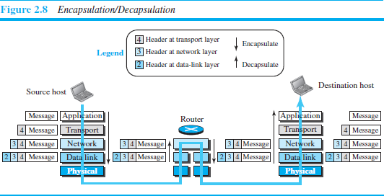
Encapsulation and Decapsulation

Slide 31
Encapsulation at the Source Host
At the application layer, the data to be exchanged is referred to as a message. It does not contain header or trailer and message is passed to transport layer.
The transport layer takes the message as the payload, the load that the transport layer should take care of. It adds the transport layer header to the payload, which contains the identifiers of the source and destination application programs plus some more information that is needed for the end-to end delivery of the message, such as information needed for flow, error control, or congestion control. The result is the transport-layer packet, which is called the segment(in TCP) and the user datagram (in UDP). The transport layer then passes the packet to the network layer.

Slide 32
The network layer takes the transport-layer packet as data or payload and adds its own header to the payload. The header contains the addresses of the source and destination hosts and some more information used for error checking of the header, fragmentation information, and so on. The result is the network- layer packet, called a datagram. The network layer then passes the packet to the data-link layer.
The data-link layer takes the network-layer packet as data or payload and adds its own header, which contains the link-layer addresses of the host or the next hop (the router). The result is the link-layer packet, which is called a frame. The frame is passed to the physical layer for transmission.

Slide 33
Decapsulation and Encapsulation at the Router
At the router, we have both decapsulation and encapsulation
because the router is connected to two or more links.
After the set of bits are delivered to the data-link layer, this layer decapsulates the datagram from the frame and passes it to the network layer.
The network layer only inspects the source and destination addresses in the datagram header and consults its forwarding table to find the next hop to which the datagram is to be delivered. The contents of the datagram should not be changed by the network layer in the router unless there is a need to fragment the datagram if it is too big to be passed through the next link. The datagram is then passed to the data-link layer of the next link.
The data-link layer of the next link encapsulates the datagram in a
frame and passes it to the physical layer for transmission.

Slide 34
Decapsulation at the Destination Host
At the destination host, each layer only decapsulates the packet received, removes the payload, and delivers the payload to the next- higher layer protocol until the message reaches the application layer.
decapsulation in the host involves error checking.
Addressing
we have logical communication between pairs of layers in this model.
Any communication that involves two parties needs two addresses:
source address and destination address.
Although it looks as if we need five pairs of addresses, one pair per layer, we normally have only four because the physical layer does not need addresses; the unit of data exchange at the physical layer is a bit, which definitely cannot have an address.

Slide 35
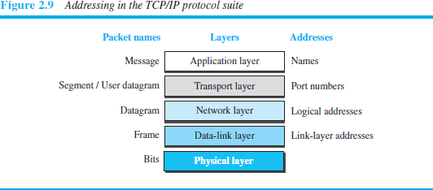
There is a relationship between the layer, the address used in that layer, and the packet name at that layer.
At the application layer, we normally use names to define the site that provides services, such as someorg.com,or the e-mail address, such as somebody@coldmail.com.

Slide 36
At the transport layer, addresses are called port numbers, and these define the application-layer programs at the source and destination.
Port numbers are local addresses that distinguish between several
programs running at the same time.
At the network-layer, the addresses are global, with the whole Internet
as the scope.
A network-layer address uniquely defines the connection of a device to
the Internet.
The link-layer addresses, sometimes called MAC addresses, are locally defined addresses, each of which defines a specific host or router in a network (LAN or WAN).

Slide 37
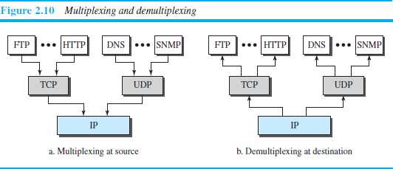
Multiplexing and Demultiplexing
Since the TCP/IP protocol suite uses several protocols at some layers, we can say that we have multiplexing at the source and demultiplexing at the destination.
Multiplexing in this case means that a protocol at a layer can encapsulate a packet from several next-higher layer protocols (one at a time)
Demultiplexing means that a protocol can decapsulate and deliver a packet to several next-higher layer protocols (one at a time).

Slide 38
To be able to multiplex and demultiplex, a protocol needs to have a field in its header to identify to which protocol the encapsulated packets belong.
At the transport layer, either UDP or TCP can accept a message from several application-layer protocols.
At the network layer, IP can accept a segment from TCP or a user datagram from UDP.
IP can also accept a packet from other protocols such as ICMP, IGMP, and so on.
At the data-link layer, a frame may carry the payload coming from IP or
other protocols such as ARP

Slide 39
THE OSI MODEL
The International Organization for Standardization (ISO) is a multinational body dedicated to worldwide agreement on international standards.
An ISO standard that covers all aspects of network communications is the Open Systems Interconnection (OSI) model. It was first introduced in the late 1970s.
ISO is the organization; OSI is the model.
An open system is a set of protocols that allows any two different
systems to communicate regardless of their underlying architecture.
The purpose of the OSI model is to show how to facilitate communication between different systems without requiring changes to the logic of the underlying hardware and software.
The OSI model is not a protocol; it is a model for understanding and designing a network architecture that is flexible, robust, and interoperable.

Slide 40
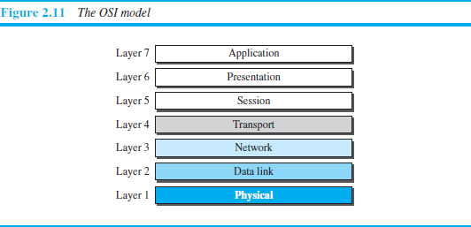
The OSI model was intended to be the basis for the creation of the
protocols in the OSI stack.
The OSI model is a layered framework for the design of network systems that allows communication between all types of computer systems.
It consists of seven separate but related layers, each of which defines a
part of the process of moving information across a network

Slide 41
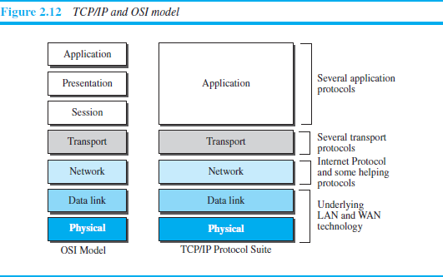
OSI versus TCP/IP
Two layers, session and presentation are missing from the TCP/IP protocol suite.
The application layer in the suite is usually considered to be the combination of three layers in the OSI model

Slide 42
TCP/IP has more than one transport-layer protocol. Some of the functionalities of the session layer are available in some of the transport-layer protocols.
The application layer is not only one piece of software. Many applications can be developed at this layer.
If some of the functionalities mentioned in the session and presentation layers are needed for a particular application, they can be included in the development of that piece of software.
Lack of OSI Model’s Success
OSI was completed when TCP/IP was fully in place and a lot of time and money had been spent on the suite; changing it would cost a lot.
Some layers in the OSI model were never fully defined.

Slide 43
For example, although the services provided by the presentation and the session layers were listed in the document, actual protocols for these two layers were not fully defined, nor were they fully described, and the corresponding software was not fully developed.
when OSI was implemented by an organization in a different application, it did not show a high enough level of performance to entice the Internet authority to switch from the TCP/IP protocol suite to the OSI model.

Slide 44
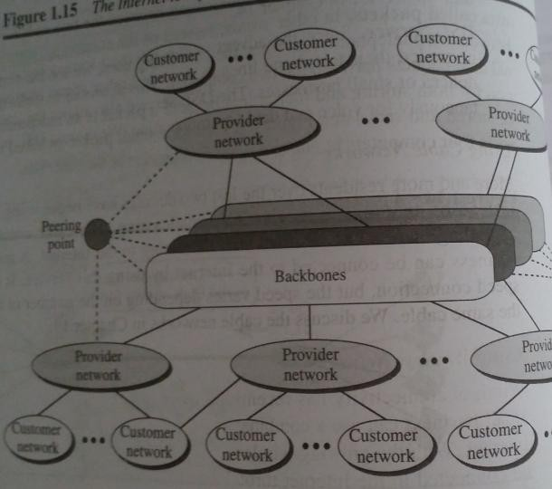
The Internet
Backbone networks are large networks owned by companies like Sprint , Verizon , AT&T and NTT. They are connected through peering points.
Provider networks are smaller networks uses the services of the backbones for a fee.
Customer networks that actually use the services provided by the internet.

Slide 45
Accessing the Internet
Using Telephone Networks
Dial up Service : To the telephone line add a modem that converts data to voice. But it is very slow when line used for internet connection.
DSL Service : Telephone companies have upgraded their telephone lines to provide higher speed internet services .
Using Cable Networks
The cable companies have been upgrading their cable networks to provide internet connection.
But speed varies depending on the number of neighbors that use the same cable.
Using Wireless Networks
A household or small business can be connected to the internet
through a wireless LAN.
Direct Connection to the internet : A large organization can become a local ISP and be connected to internet.

Slide 46
Internet
more than hundreds of thousands of
It is a collaboration of interconnected networks.
Advanced Research Projects Agency (ARPA) in the Department of Defense found a way to connect computers so that they can share their information.
ARPANET, a small network of connected computers which allows host computer attached to specialized computer called interface message processor(IMP).
Each IMP had to be able to communicate with other IMPs as well as with its attached host.
ARPANET was split in to two networks: Military Network(MILNET) for military users and ARPANET for non military users.

Slide 47
Internet
Computer Science Network(CSNET) was a network sponsored by the National Science Foundation. It is a less expensive network and the transmission rate was slower.
National Science Foundation Network(NSFNET) was a backbone network that connected five supercomputer centers located throughout the United states . It was not supporting rapidly increased internet traffic.
Advanced Network Services Network(ANSNET) provides a high speed internet .

Slide 48
Standards and Administration
Internet Standard : It is a formalized regulation that must be followed and useful to those who work with the internet.
An Internet draft is a working document with no official status and a six month life time.
This draft is published as a Request for comment(RFC) where each RFC is edited , assigned a number and made available to all interested parties.

Slide 49
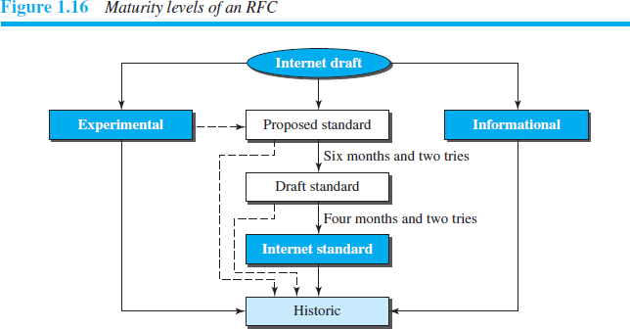

Slide 50
Maturity Levels
Proposed standard : It is a specification which is stable, understood and of sufficient interest to the Internet community.
Draft standard : A proposed standard is elevated to draft standard status after at least two successful independent and interoperable implementations.
Internet standard : A draft standard reaches internet standard after demonstrations of successful implementation.
Historic : They have never passed the necessary maturity levels to become an internet standard.
Experimental : It describes work related to an experimental operation that does not affect the operation of the internet.
Informational : It contains general , historical or tutorial information related to the internet .

Slide 51
Requirement Levels
Required : An RFC is labeled required if it is implemented by all
internet systems to achieve minimum conformance.
Eg : IP and ICMP are required protocols
Recommended : An RFC is labeled recommended if it is not required for minimum conformance.
Eg : FTP and TELNET are recommended protocols
Elective : An RFC is labeled elective is not required and not recommended. However, a system can use it for its own benefit.
Limited Use : An RFC is labeled limited use should be used only in limited situation
Eg: experimental RFCs.
Not Recommended : An RFC inappropriate for general use.
Eg:historic RFCs.
is labeled not recommended is

Slide 52
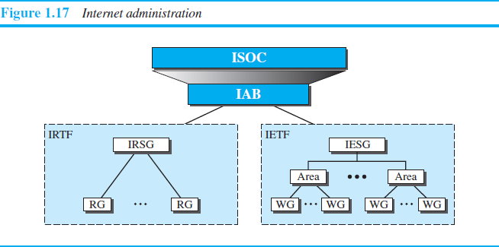
Internet Administration
The Internet, with its roots primarily in the research domain.
Various groups that coordinate Internet issues have guided this
growth and development.
Figure below shows the general organization of Internet administration

Slide 53
Internet Society (ISOC)
ISOC is an international, nonprofit organization formed in 1992 to provide support for the Internet standards process.
ISOC accomplishes this through maintaining and supporting other Internet administrative bodies such as IAB,IETF, IRTF, and IANA .
Also promotes research and other scholarly activities relating to
the Internet.
Internet Architecture Board (IAB)
The IAB is the technical advisor to the ISOC.
Purposes
oversee the continuing development of the TCP/IP
Protocol Suite
serve in a technical advisory capacity to research members of
the Internet community.

Slide 54
IAB accomplishes this through its two primary components: 1.Internet Engineering Task Force (IETF)
2.Internet Research Task Force (IRTF).
Another responsibility of the IAB is the editorial management
of the RFCs.
Internet Engineering Task Force(IETF )
Forum of working groups managed by the Internet Engineering
Steering Group (IESG).
Responsible for identifying operational problems and
proposing solutions to these problems.
Also develops and reviews specifications intended as Internet standards.

Slide 55
Internet Research Task Force (IRTF )
forum of working groups managed by Steering Group (IRSG).
focuses on long-term research topics
Internet Research
related to Internet
protocols, applications, architecture, and technology.

Slide 56
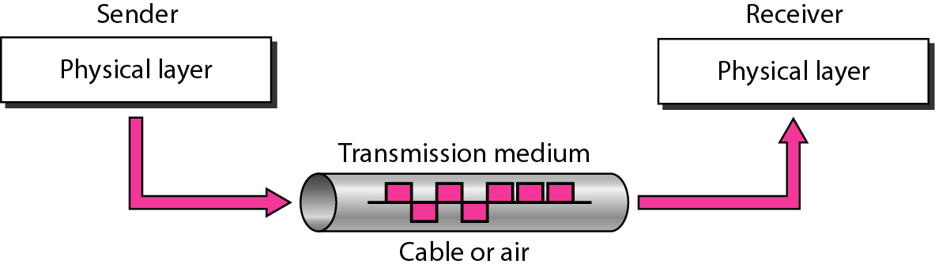
Figure 7.1 Transmission medium and physical layer

Slide 57
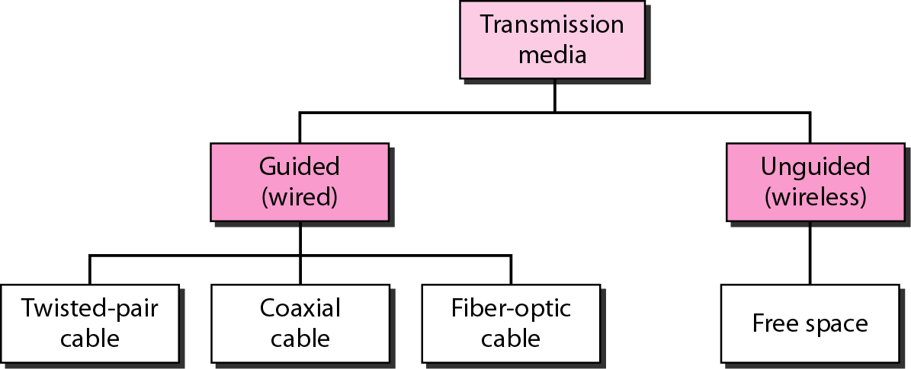
Figure 7.2 Classes of transmission media

Slide 58
7-1 GUIDED MEDIA
Guided media, which are those that provide a conduit from one device to another, include twisted-pair cable, coaxial cable, and fiber-optic cable.
Topics discussed in this section:
Twisted-Pair Cable Coaxial Cable Fiber-Optic Cable

Slide 59
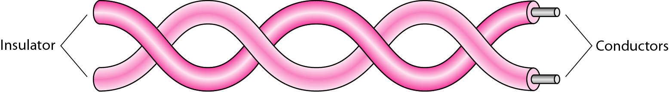
Figure 7.3 Twisted-pair cable

Slide 60
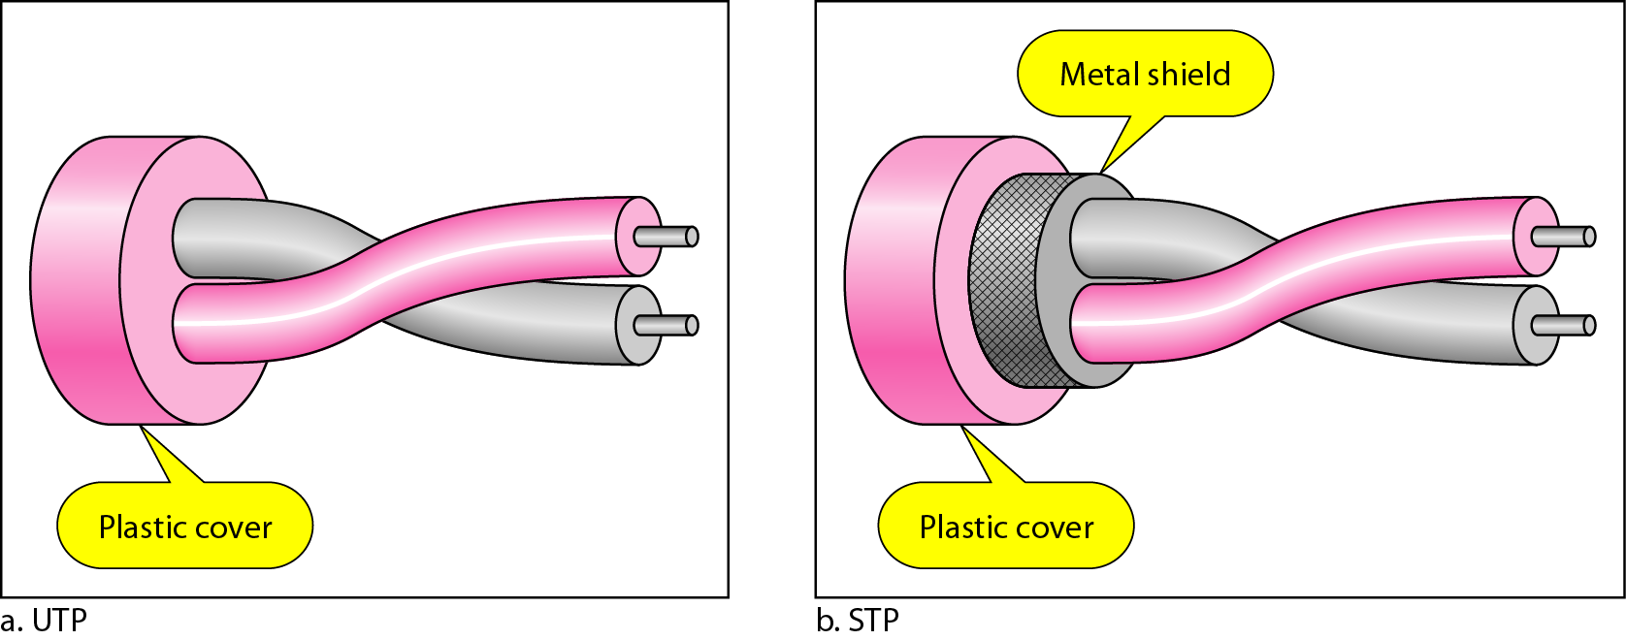
Figure 7.4 UTP and STP cables

Slide 61
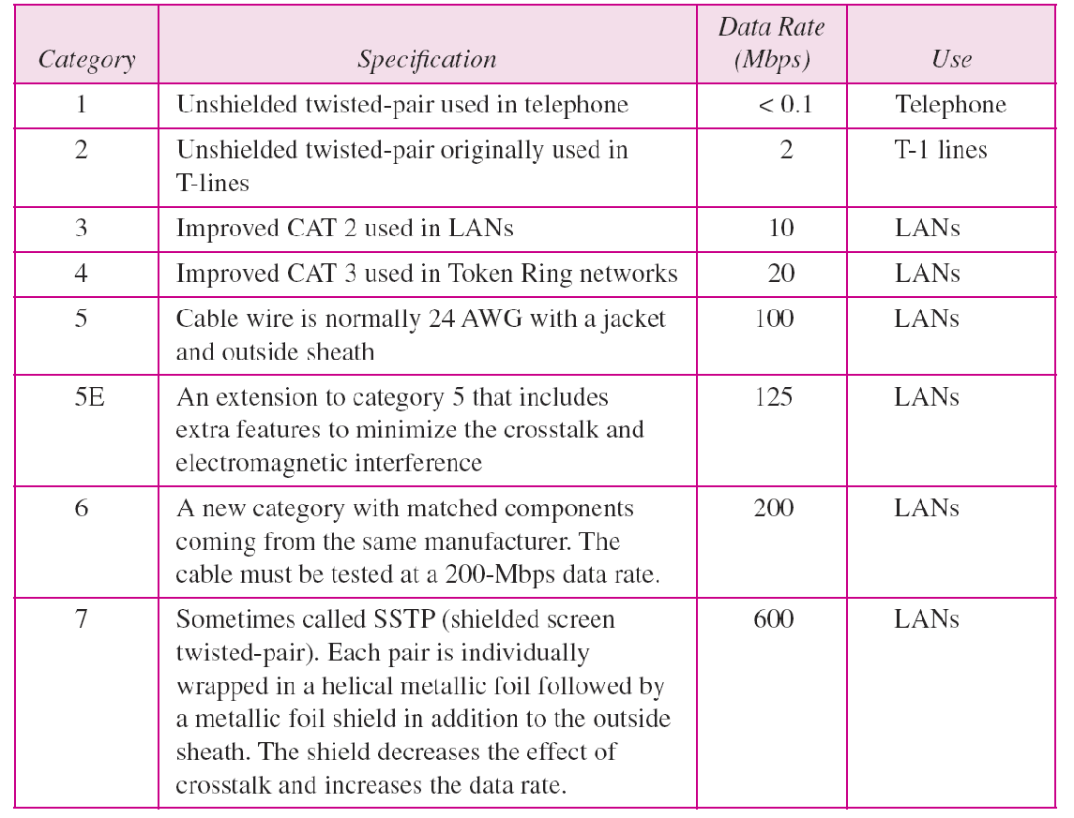
Table 7.1 Categories of unshielded twisted-pair cables

Slide 62
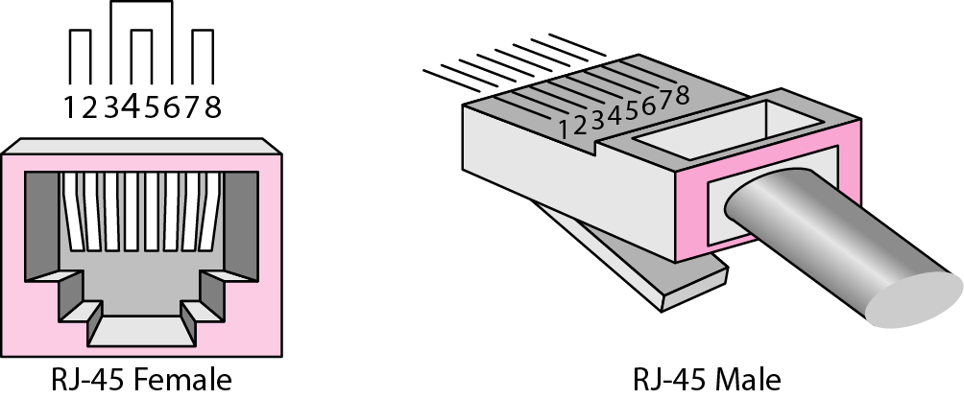
Figure 7.5 UTP connector

Slide 63
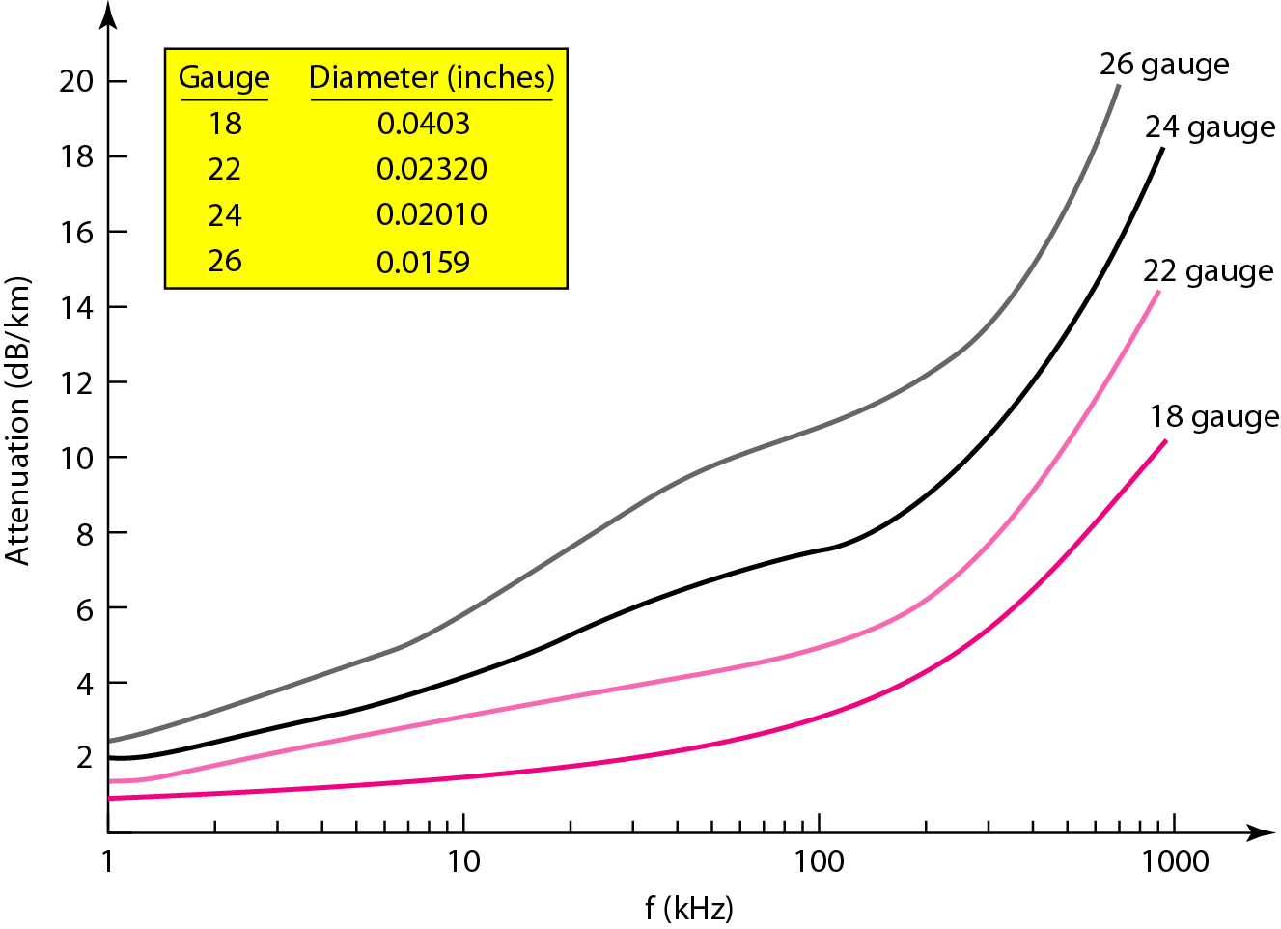
Figure 7.6 UTP performance

Slide 64
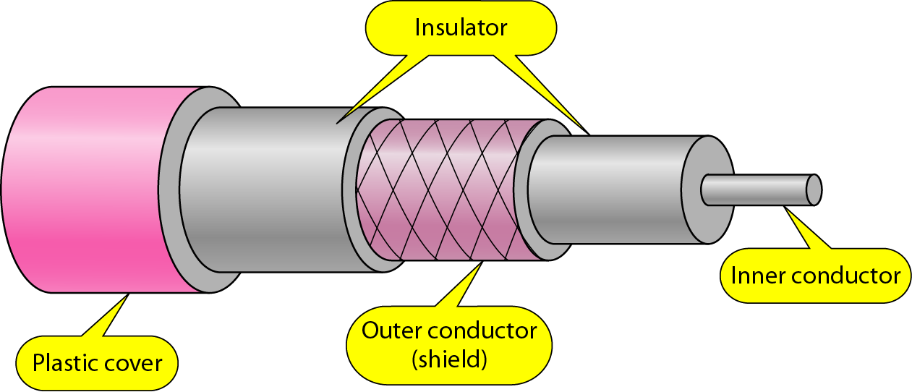
Figure 7.7 Coaxial cable

Slide 65
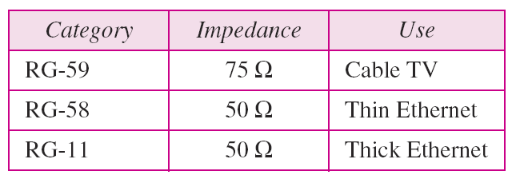
Table 7.2 Categories of coaxial cables

Slide 66
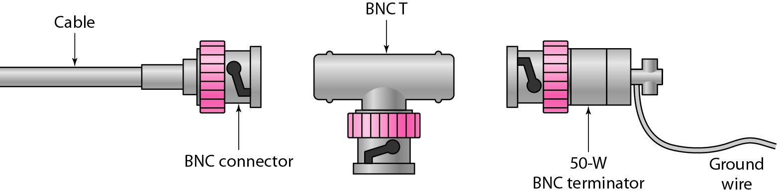
Figure 7.8 BNC connectors

Slide 67
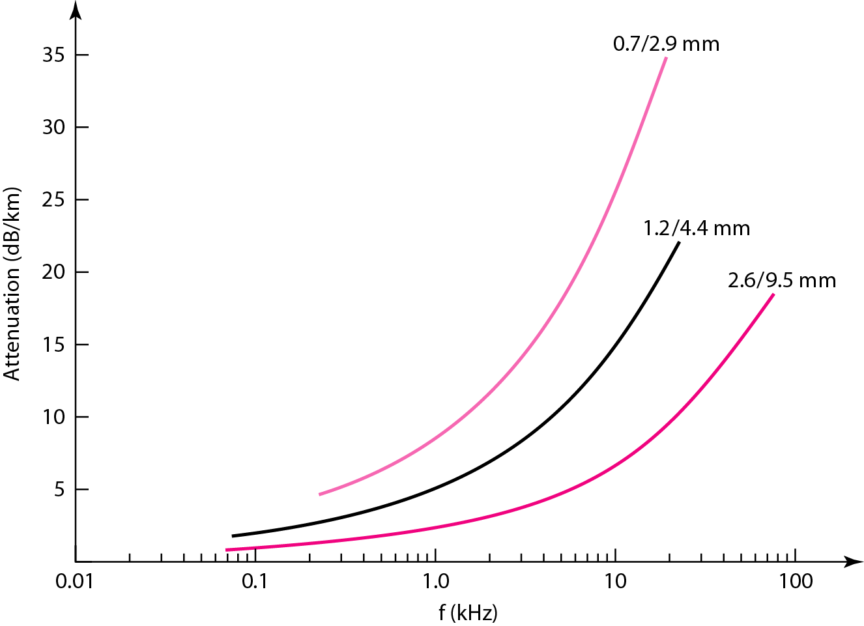
Figure 7.9 Coaxial cable performance

Slide 68
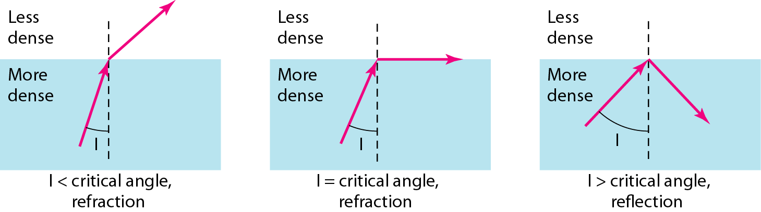
Figure 7.10 Fiber optics: Bending of light ray

Slide 69
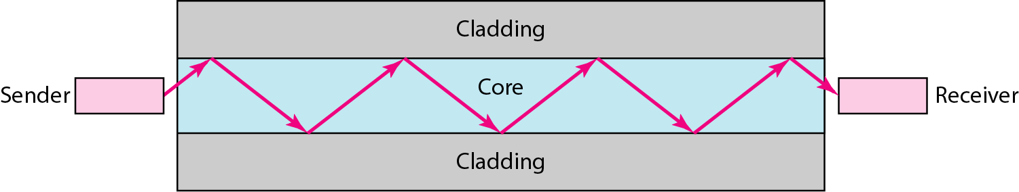
Figure 7.11 Optical fiber

Slide 70
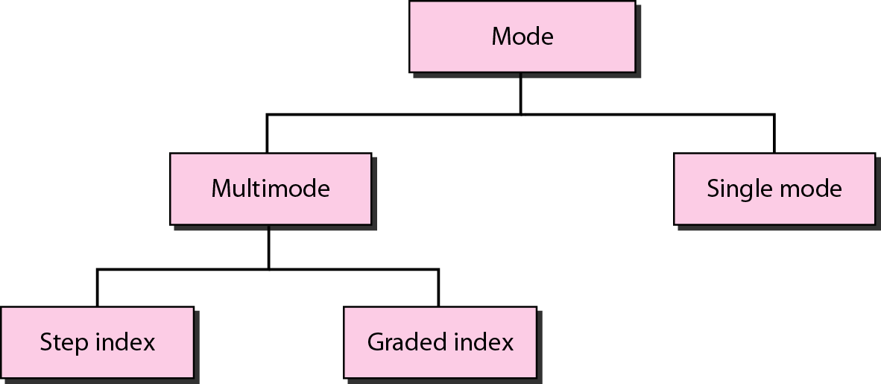
Figure 7.12 Propagation modes

Slide 71
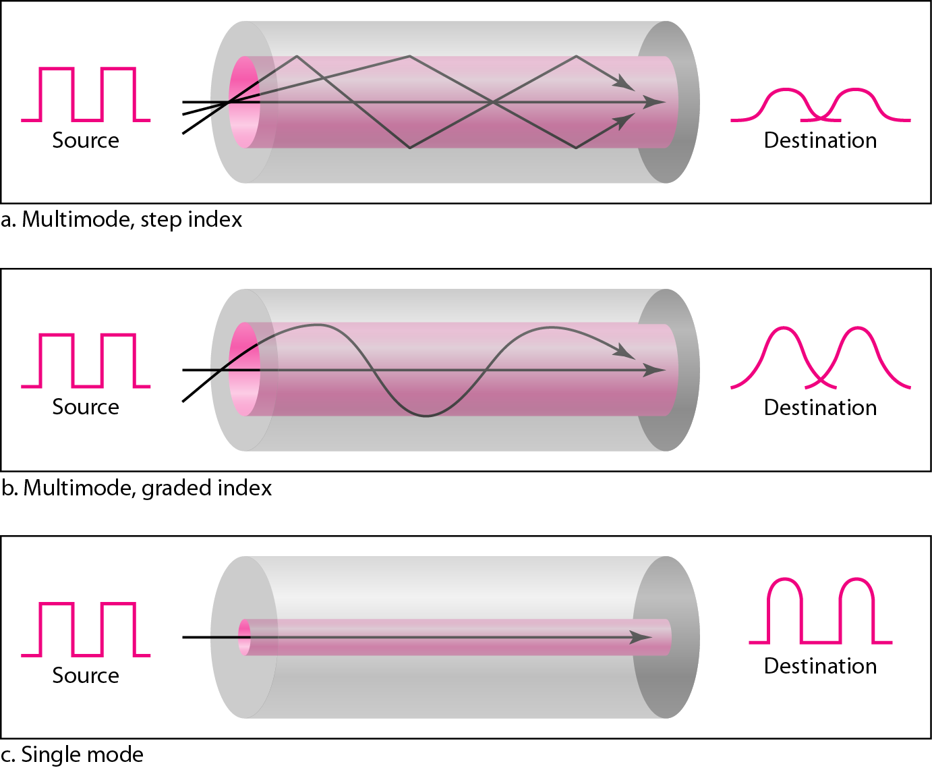
Figure 7.13 Modes

Slide 72
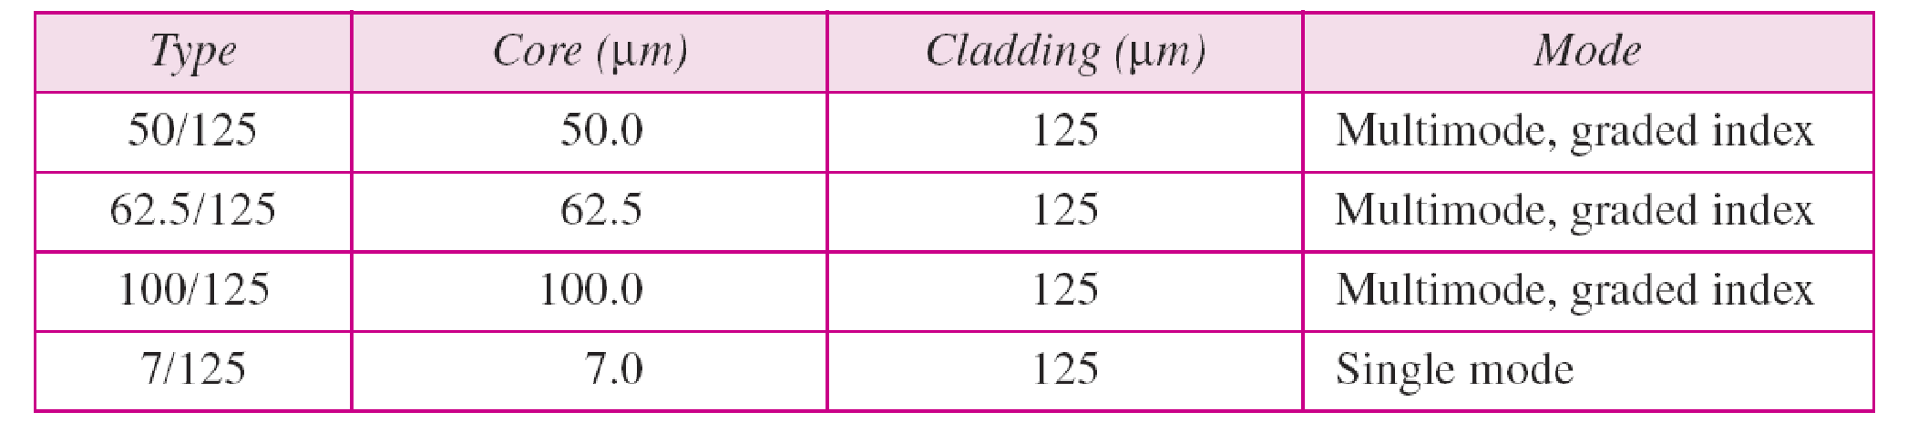
Table 7.3 Fiber types

Slide 73
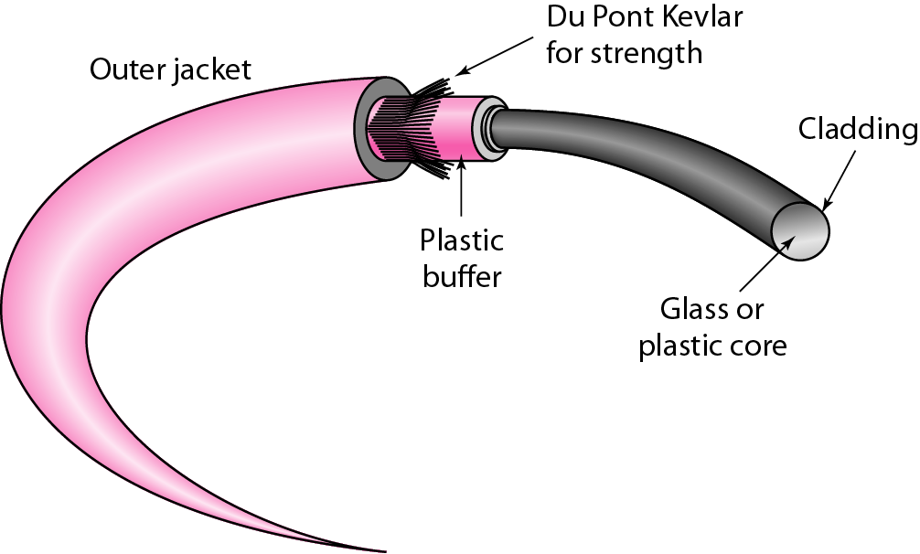
Figure 7.14 Fiber construction

Slide 74
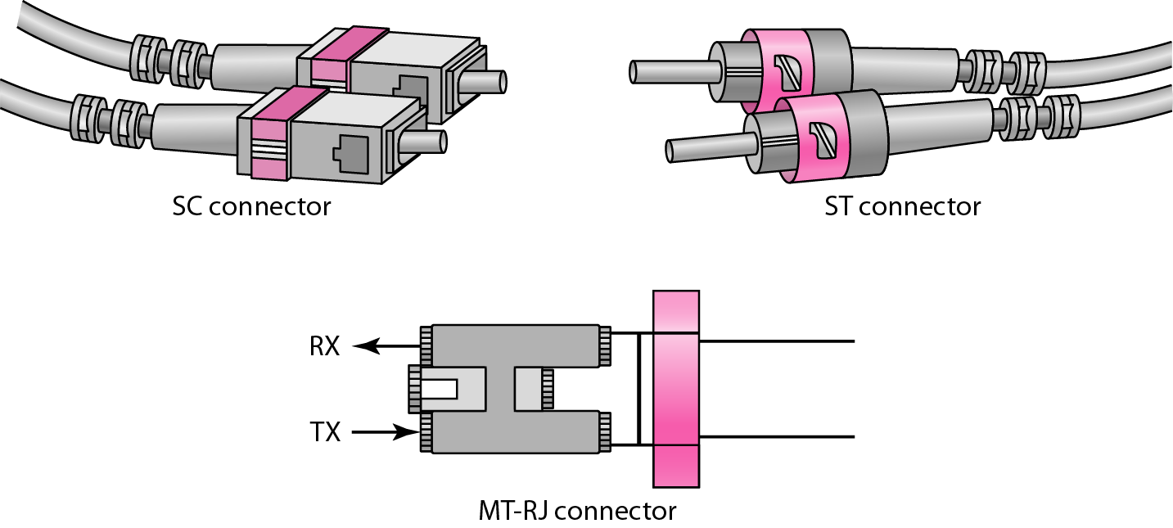
Figure 7.15 Fiber-optic cable connectors

Slide 75
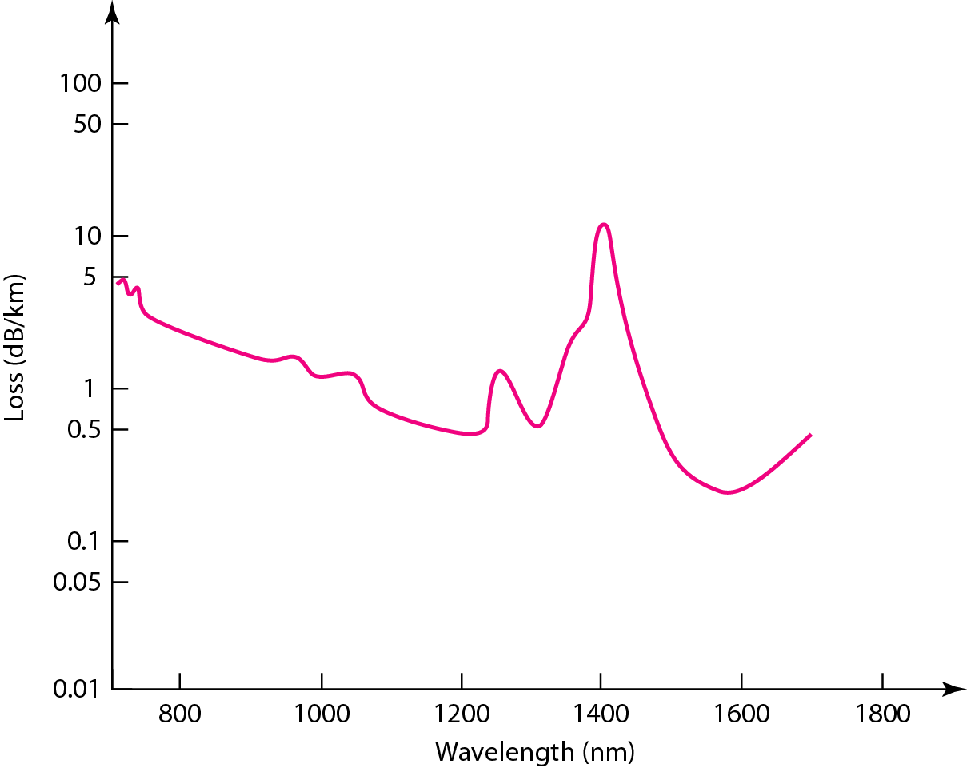
Figure 7.16 Optical fiber performance

Slide 76
7-2 UNGUIDED MEDIA: WIRELESS
Unguided media transport electromagnetic waves without using a physical conductor. This type of communication is often referred to as wireless communication.
Topics discussed in this section:
Radio Waves
Microwaves
Infrared

Slide 77
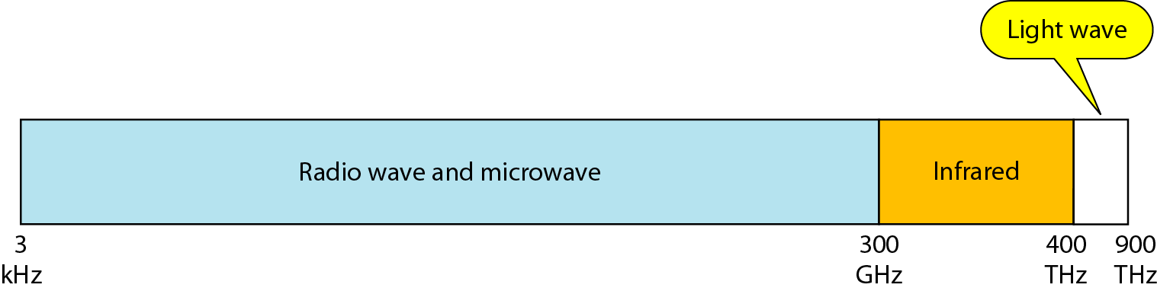
Figure 7.17 Electromagnetic spectrum for wireless communication

Slide 78
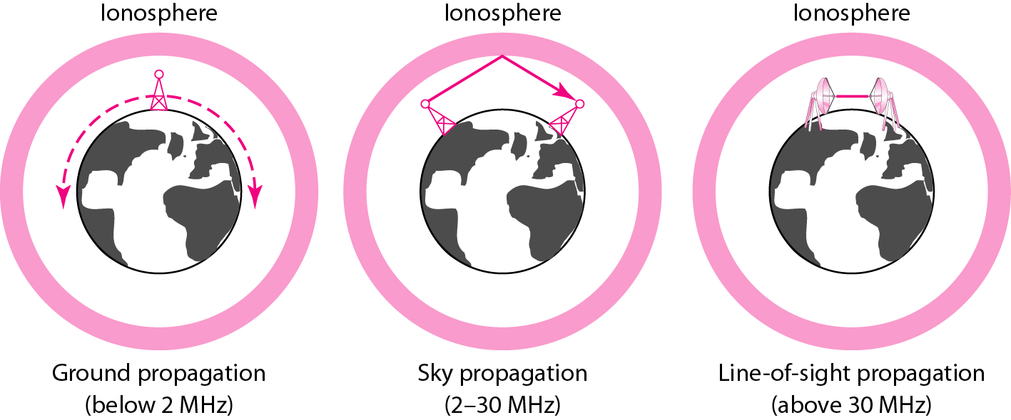
Figure 7.18 Propagation methods

Slide 79
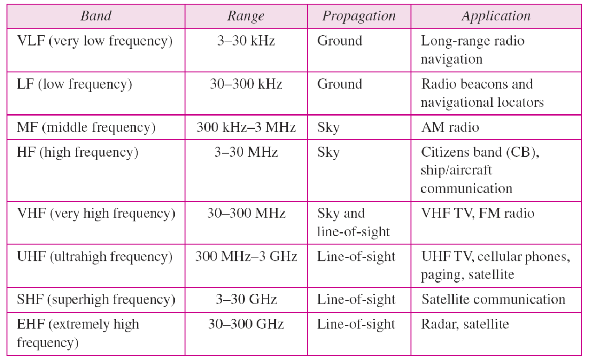
Table 7.4 Bands

Slide 80
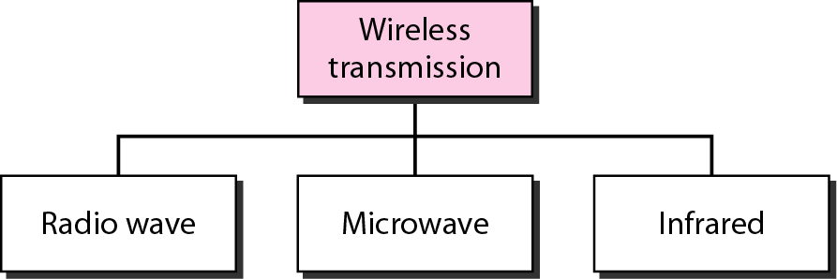
Figure 7.19 Wireless transmission waves

Slide 81

Note
Radio waves are used for multicast communications, such as radio and television, and paging systems. They can penetrate through walls.
Highly regulated. Use omni directional antennas

Slide 82
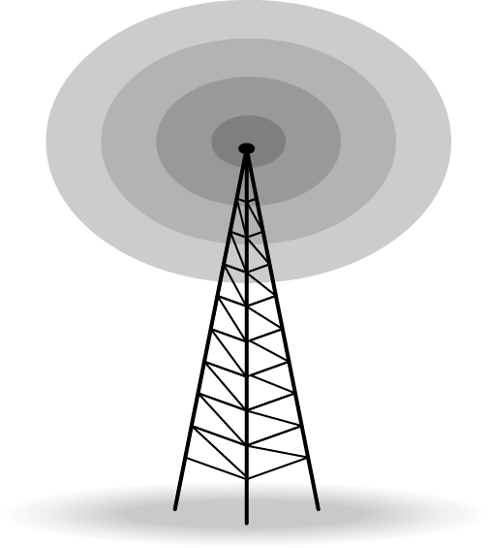
Figure 7.20 Omnidirectional antenna

Slide 83
Note
Microwaves are used for unicast communication such as cellular telephones, satellite networks, and wireless LANs.
Higher frequency ranges cannot penetrate walls.
Use directional antennas - point to point line of sight communications.

Slide 84
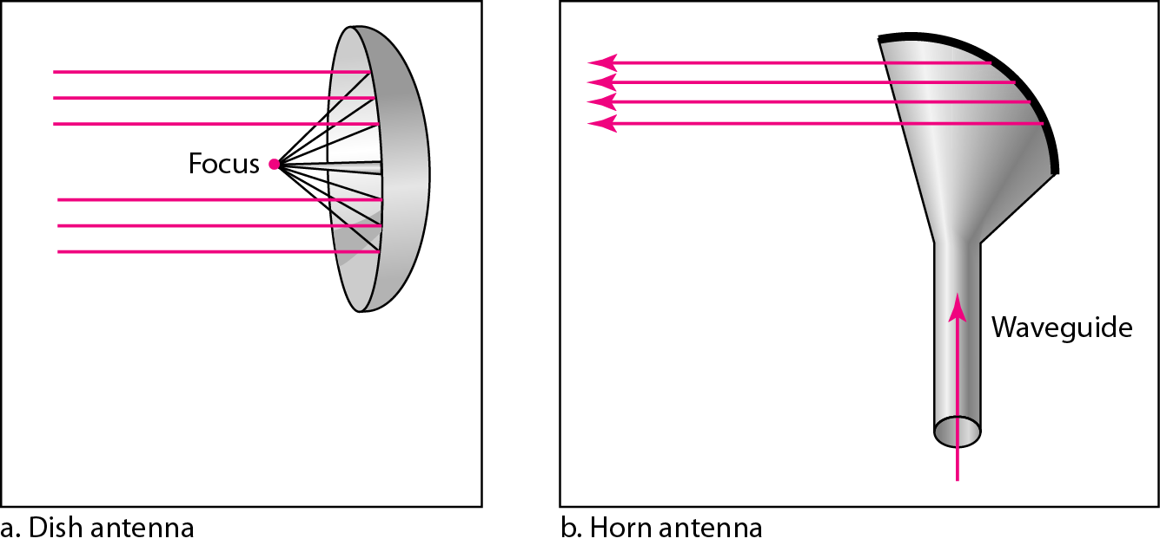
Figure 7.21 Unidirectional antennas

Slide 85
Note
Infrared signals can be used for short-range communication in a closed area using line-of-sight propagation.

Slide 86
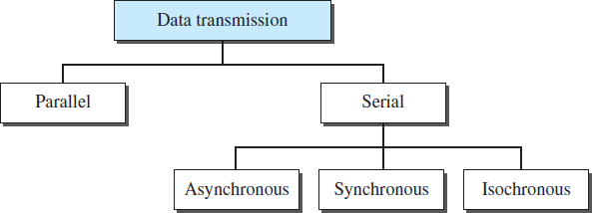
TRANSMISSION MODES
The transmission of binary data across a link can be accomplished in
either parallel or serial mode.

Slide 87
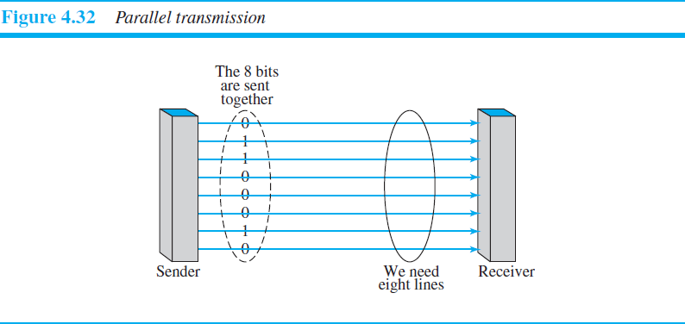
Parallel Transmission
Here multiple bits are sent with each clock.
Binary data, consisting of 1s and 0s, may be organized into groups of n bits each.
Use n wires to send n bits at one time. That way each bit has its own wire, and all n bits of one group can be transmitted with each clock tick from one device to another.

Slide 88
Advantage:
Speed : Parallel transmission can increase the transfer speed by a factor of n over serial transmission.
Disadvantage:
Cost : Parallel transmission requires n communication lines just totransmit the data stream.

Slide 89
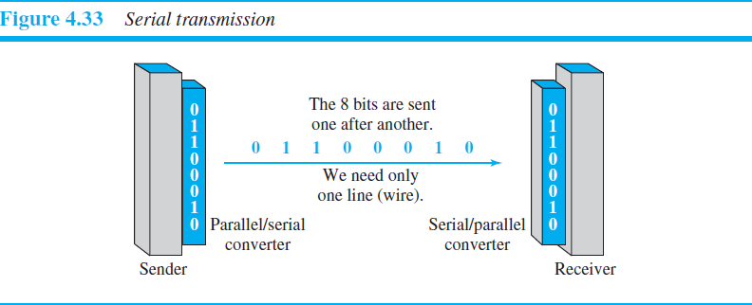
Serial Transmission
Here 1 bit is sent with each clock tick.
One bit follows another, so we need only one communication channel
rather than n to transmit data between two communicating .

Slide 90
Advantage:
The advantage of serial over parallel transmission is that with only one communication channel.
Serial transmission reduces the cost of transmission over parallel by roughly a factor of n
Serial transmission occurs in one of three ways:
Asynchronous
Synchronous
Isochronous.

Slide 91
Asynchronous Transmission
In this mode we send 1 start bit (0) at the beginning and 1 or more stop bit (1s) at the end of each byte.
Asynchronous transmission is so named because the timing of a signal is unimportant.
Information is received and translated by agreed upon patterns. Patterns are based on grouping the bit stream in to bytes.
Without synchronization, the receiver cannot use timing to predict when the next group will arrive.
To alert the receiver to the arrival of a new group, therefore, an extra bit is added to the beginning of each byte. This bit, usually a 0, is called the start bit.
To let the receiver know that the byte is finished, 1 or more additional bits are appended to the end of the byte.

Slide 92
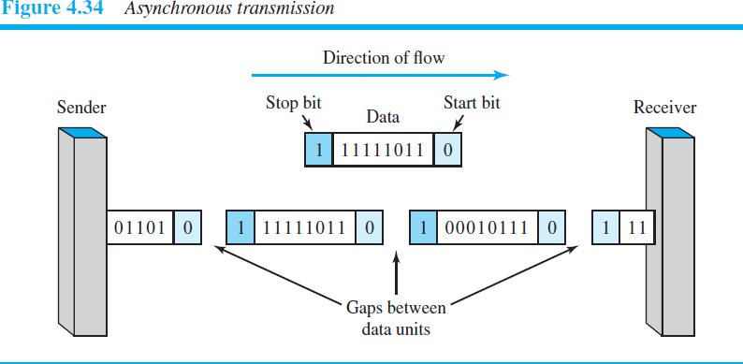
In addition, the transmission of each byte may then be followed by a gap of varying duration. This gap can be represented either by an idle channel or by a stream of additional stop bits.
The start and stop bits and the gap alert the receiver to the beginning and
end of each byte and allow it to synchronize with the data stream.
When the receiver detects a start bit, it sets a timer and begins counting bits as they come in. After n bits, the receiver looks for a stop bit. As soon as it detects the stop bit, it waits until it detects the next start bit.

Slide 93
Synchronous Transmission
Here the bit stream is combined into longer “frames,” which may contain
multiple bytes.
Each byte, is introduced onto the transmission link without a gap
between it and the next one.
It is left to the receiver to separate the bit stream into bytes for decoding purposes.
Here we send bits one after another without start or stop bits or gaps. It
is the responsibility of the receiver to group the bits.

Slide 94
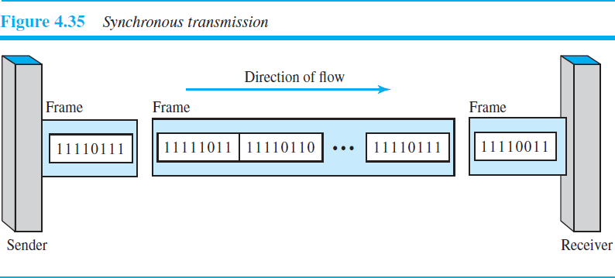

Slide 95
Timing becomes very important, therefore, because the accuracy of the received information is completely dependent on the ability of the receiving device to keep an accurate count of the bits as they come in.
Advantage :
Speed : With no extra bits or gaps to introduce at the sending end and remove at the receiving end, and, by extension, with fewer bits to move across the link, synchronous transmission is faster than asynchronous transmission.
Isochronous Transmission
This mode provides synchronization for the entire stream of bits.
It is used with real time audio and video applications.
In real-time audio and video, in which uneven delays between frames are
not acceptable, synchronous transmission fails.

Slide 96
For example, TV images are broadcast at the rate of 30 images per
second; they must be viewed at the same rate.
If each image is sent by using one or more frames, there should be no delays between frames.
For this type of application, synchronization between characters is
not enough; the entire stream of bits must be synchronized.
The isochronous transmission guarantees that the data arrive at a fixed rate.

Slide 97
Physical Layer-1
Data and Signals
Data need to be transmitted and received, but the media have to change data to signals. Both data and the signals that represent them can be either analog or digital in form.
Analog data refers to information that is continuous.
For example, an analog clock that has hour, minute, and second hands gives information in a continuous form; the movements of the hands are continuous.
Digital data refers to information that has discrete states. For example, digital clock that reports the hours and the minutes will change suddenly from 8:05 to 8:06.

Slide 98




Data and Signals
Data need to be transmitted and received, but the media have to
change data to signals.
Both data and the signals that represent them can be either analog
or digital in form.
Analog data refers to information that is continuous.
For example, an analog clock that has hour, minute, and second hands gives information in a continuous form; the movements of the hands are continuous.
Digital data refers to information that has discrete states.
For example, digital clock that reports the hours and the minutes will change suddenly from 8:05 to 8:06.
2.82

Slide 99


Analog and Digital Signals
Analog data, such as the sounds made by a human voice, take on continuous values.
Digital data are the data stored in computer memory in the form of 0s and 1s. They can be converted to a digital signal
An analog signal has infinitely many levels of intensity over a period of time. As the wave moves from value A to value B, it passes through and includes an infinite number of values along its path.
A digital signal, on the other hand, can have only a limited number of defined values. Although each value can be any number, it is often as simple as 1 and 0.
3.83

Slide 100
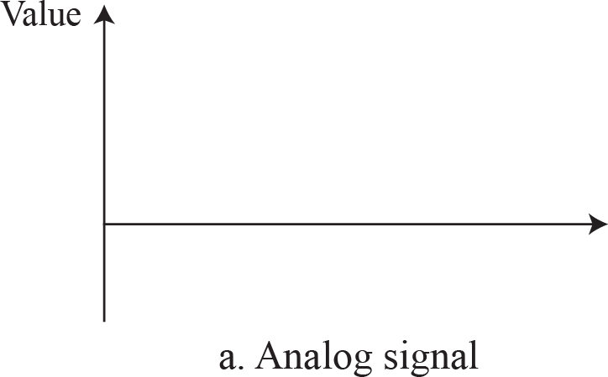

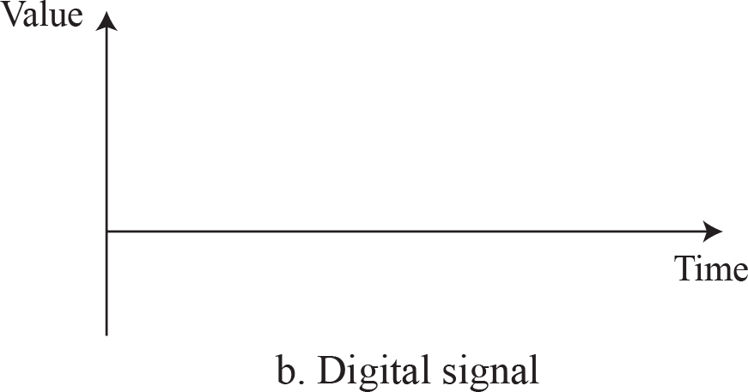
Figure 3.2: Comparison of analog and digital signals

Slide 101

Periodic and Nonperiodic
A periodic signal completes a pattern within a measurable time frame, called a period, and repeats that pattern over subsequent identical periods.
The completion of one full pattern is called a cycle.
A non periodic signal changes without exhibiting a pattern or cycle that repeats over time.
Both analog and digital signals can be periodic or non
periodic.
In data communication, we commonly use periodic analog signals and non periodic digital signals.
3.85

Slide 102



Sine Wave
The sine wave is the most fundamental form of a periodic analog signal.
Value
• • •
Time
A sine wave can be represented by three parameters: the peak amplitude, the frequency ,and the phase.

Slide 103
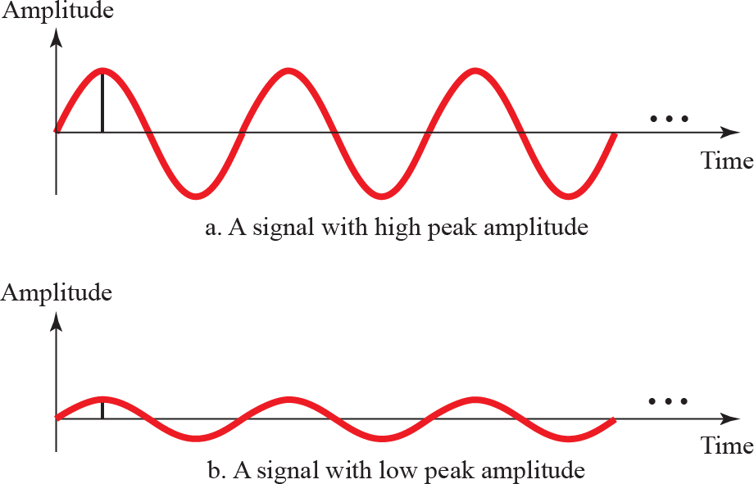
Peak Amplitude
The peak amplitude of a signal is the absolute value of its highest intensity, proportional to the energy it carries
Peak amplitude
Peak amplitude
Figure 3.4: Two signals with two different amplitudes

Slide 104
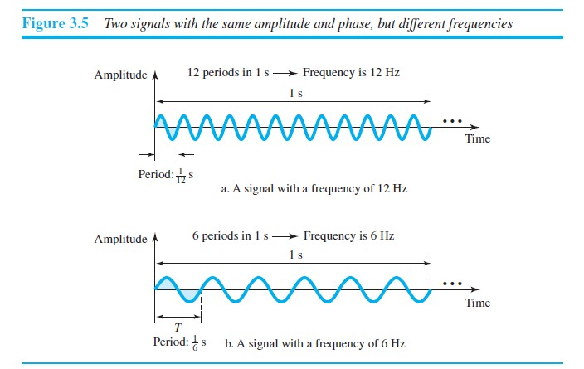
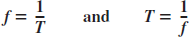
Period and Frequency
Period refers to the amount of time, in seconds, a signal needs to complete 1 cycle.
Frequency refers to the number of periods in 1 s.
Frequency and period are the inverse of each other.

Slide 105

Phase
The term phase, or phase shift, describes the position of the
waveform relative to time 0.

Slide 106
A sine wave with a phase of 0° starts at time 0 with a zero amplitude. The amplitude is increasing.
A sine wave with a phase of 90° starts at time 0 with a peak amplitude.
The amplitude is decreasing.
A sine wave with a phase of 180° starts at time 0 with a zero amplitude. The amplitude is decreasing.
Another way to look at the phase is in terms of shift or offset. We can say that
A sine wave with a phase of 0° is not shifted.
A sine wave with a phase of 90° is shifted to the left by ¼ cycle
However, note that the signal does not really exist before time 0.
A sine wave with a phase of 180° is shifted to the left by ½ cycle. However, note that the signal does not really exist before time 0.

Slide 107
Digital Signals
In addition to being represented by an analog signal, information can
also be represented by a digital signal.
For example, 1 can be encoded as a positive voltage and a 0 as zero
voltage.
A digital signal can have more than two levels. In this case, we can send
more than 1 bit for each level.

Slide 108

8.Complexity
A complex scheme is more costly to implement than a simple one.
For example, a scheme that uses four signal levels is more difficult to
interpret than one that uses only two levels.
Line Coding Schemes

Slide 109

Unipolar Scheme
In a unipolar scheme, all the signal levels are on one side of the time
axis
NRZ (Non-Return-to-Zero)
Traditionally, a unipolar scheme was designed as a non-return-to- zero (NRZ) scheme in which the positive voltage defines bit 1 and the zero voltage defines bit 0.
It is called NRZ because the signal does not return to zero at the
middle of the bit.

Slide 110
Polar Schemes
In polar schemes, the voltages are on both sides of the time axis.
For example, the voltage level for 0 can be positive and the voltage
level for 1 can be negative.
Non-Return-to-Zero (NRZ)
In polar NRZ encoding, we use two levels of voltage amplitude.
We can have two versions of polar NRZ:
NRZ-L (NRZ-Level): the level of the voltage determines the value
of the bit
NRZ-I (NRZ-Invert):the change or lack of change in the level of
the voltage determines the value of the bit. If there is no change, the bit is 0; if there is a change, the bit is 1.

Slide 111


Slide 112

Return-to-Zero (RZ)
Uses three values: positive, negative, and zero.
In RZ, the signal changes not between bits but during the bit.
As shown in the figure the signal goes to 0 in the middle of each bit. It remains there until the beginning of the next bit.

Slide 113
Biphase: Manchester and Differential Manchester
The idea of RZ (transition at the middle of the bit) and the idea of
NRZ-L are combined into the Manchester scheme.
In Manchester encoding, the duration of the bit is divided into two
halves. The voltage remains at one level during the first half and moves to the other level in the second half. The transition at the
middle of the bit provides synchronization.
Differential Manchester, on the other hand, combines the ideas of
RZ and NRZ-I. There is always a transition at the middle of the bit, but the bit values are determined at the beginning of the bit. If the next bit is 0, there is a transition; if the next bit is 1,

Slide 114


Slide 115
Bipolar Schemes
In bipolar encoding (sometimes called multilevel binary), there are
three voltage levels: positive, negative, and zero.
The voltage level for one data element is at zero, while the voltage level for the other element alternates between positive and negative.
Two variations of bipolar encoding: AMI and pseudoternary
In the term alternate mark inversion, the word mark comes from
telegraphy and means 1.
So AMI means alternate 1 inversion. A neutral zero voltage represents binary 0. Binary 1s are represented by alternating positive and negative voltages.
A variation of AMI encoding is called pseudoternary in which the 1 bit is encoded as a zero voltage and the 0 bit is encoded as alternating positive and negative voltages.

Slide 116


Slide 117

Summary of line coding schemes

Slide 118


Slide 119


Slide 120


Slide 121


Slide 122


Slide 123


Slide 124


Slide 125


Slide 126


Slide 127
CYCLIC CODES
Cyclic codes are special linear block codes with one extra property. In a cyclic code, if a codeword is cyclically shifted (rotated), the result is another codeword.
Topics discussed in this section:
Cyclic Redundancy Check Hardware Implementation Polynomials Cyclic Code Analysis
Advantages of Cyclic Codes Other Cyclic Codes

Slide 128

A CRC code with C(7, 4)

Slide 129

CRC encoder and decoder

Slide 130

Division in CRC encoder

Slide 131

Figure 10.16 Division in the CRC decoder for two cases

Slide 132

Figure 10.17 Hardwired design of the divisor in CRC

Slide 133

Figure 10.18 Simulation of division in CRC encoder

Slide 134

Figure 10.19 The CRC encoder design using shift registers
Figure 10.20 General design of encoder and decoder of a CRC code

Slide 135
Using Polynomials
We can use a polynomial to represent a binary word.
Each bit from right to left is mapped onto a power term.
The rightmost bit represents the “0” power term. The bit next to it the “1” power term, etc.
If the bit is of value zero, the power term is deleted from the expression.

Slide 136

Figure 10.21 A polynomial to represent a binary word

Slide 137

Figure 10.22 CRC division using polynomials

Slide 138
NOTE:
The divisor in a cyclic code is normally called the generator polynomial or simply the generator.
In a cyclic code,
If s(x) ≠ 0, one or more bits is corrupted.
If s(x) = 0, either
a. No bit is corrupted. or
b. Some bits are corrupted, but the decoder failed to detect them.
3) In a cyclic code, those e(x) errors that are divisible by g(x) are not caught. Received codeword (c(x) + e(x))/g(x) = c(x)/g(x) + e(x)/gx
The first part is by definition divisible the second part will determine the error. If “0”conclusion -> no error occured.That could mean that an error went undetected.
4) If the generator has more than one term and the coefficient of x⁰ is 1, all single errors can be caught.

Slide 139
Example 1.1
Which of the following g(x) values guarantees that a single-bit error is caught? For each case, what is the error that cannot be caught?
x + 1 b. x³ c. 1
Solution
a. No x^{i} can be divisible by x + 1. Any single-bit error can be caught.
b. If i is equal to or greater than 3, x^{i} is divisible by g(x). All single-bit errors in positions 1 to 3 are caught.
c. All values of i make x^{i} divisible by g(x). No single-bit error can be caught. This g(x) is useless.

Slide 140

Figure 10.23 Representation of two isolated single-bit errors using polynomials
NOTE: If a generator cannot divide x^{t} + 1 (t between 0 and n – 1),
then all isolated double errors can be detected.

Slide 141
Example 1.2
Find the status of the following generators related to two isolated, single-bit errors.
x + 1 b. x⁴ + 1 c. x⁷ + x⁶ + 1 d. x¹⁵ + x¹⁴ + 1
Solution
a. This is a very poor choice for a generator. Any two errors next to each other cannot be detected.
b. This generator cannot detect two errors that are four positions apart.
c. This is a good choice for this purpose.
d. This polynomial cannot divide x^{t} + 1 if t is less than 32,768. A codeword with two isolated errors up to 32,768 bits apart can be detected by this generator.

Slide 142
NOTE:
A generator that contains a factor of x + 1 can detect all odd-numbered errors
All burst errors with L ≤ r will be detected.
All burst errors with L = r + 1 will be detected with probability 1 – (1/2)^{r–1}.
All burst errors with L > r + 1 will be detected with probability 1 – (1/2)^{r}.

Slide 143
Example 10.17
Find the suitability of the following generators in relation to burst errors of different lengths.
a. x⁶ + 1 b. x¹⁸ + x⁷ + x + 1 c. x³² + x²³ + x⁷ + 1
Solution
a. This generator can detect all burst errors with a length less than or equal to 6 bits; 3 out of 100 burst errors with length 7 will slip by; 16 out of 1000 burst errors of length 8 or more will slip by.

Slide 144
b. This generator can detect all burst errors with a length less than or equal to 18 bits; 8 out of 1 million burst errors with length 19 will slip by; 4 out of 1 million burst errors of length 20 or more will slip by.
c. This generator can detect all burst errors with a length less than or equal to 32 bits; 5 out of 10 billion burst errors with length 33 will slip by; 3 out of 10 billion burst errors of length 34 or more will slip by.

Slide 145
NOTE:
A good polynomial generator needs to have the following characteristics:
1. It should have at least two terms.
2. The coefficient of the term x⁰ should be 1.
3. It should not divide x^{t} + 1, for t between 2 and n − 1.
4. It should have the factor x + 1.

Slide 146
Data Link Layer Protocols
What is flow control?
Ensuring the sending entity does not overwhelm the receiving entity
Preventing buffer overflow
Transmission time
Time taken to emit all bits into medium
Propagation time
Time for a bit to traverse the link

Slide 147

Model of Frame Transmission

Slide 148
Stop and Wait
Source transmits frame
Destination receives frame and replies with acknowledgement
Source waits for ACK before sending next frame
Destination can stop flow by not send ACK
Works well for a few large frames

Slide 149
Fragmentation
Large block of data may be split into small frames
Limited buffer size
Errors detected sooner (when whole frame received)
On error, retransmission of smaller frames is needed
Prevents one station occupying medium for long periods
Stop and wait becomes inadequate

Slide 150

Stop and Wait Link Utilization

Slide 151
Sliding Windows Flow Control
Allow multiple frames to be in transit
Receiver has buffer W long
Transmitter can send up to W frames without ACK
Each frame is numbered
ACK includes number of next frame expected
Sequence number bounded by size of field (k)
Frames are numbered modulo 2^{k}

Slide 152

Sliding Window Diagram

Slide 153

Example Sliding Window

Slide 154
Sliding Window Enhancements
Receiver can acknowledge frames without permitting further transmission (Receive Not Ready)
Must send a normal acknowledge to resume
If duplex, use piggybacking
If no data to send, use acknowledgement frame
If data but no acknowledgement to send, send last acknowledgement number again, or have ACK valid flag (TCP)

Slide 155
Error Control
Detection and correction of errors
Lost frames
Damaged frames
Automatic repeat request
Error detection
Positive acknowledgment
Retransmission after timeout
Negative acknowledgement and retransmission

Slide 156
Automatic Repeat Request (ARQ)
Stop and wait
Go back N
Selective reject (selective retransmission)

Slide 157
Stop and Wait
Source transmits single frame
Wait for ACK
If received frame damaged, discard it
Transmitter has timeout
If no ACK within timeout, retransmit
If ACK damaged,transmitter will not recognize it
Transmitter will retransmit
Receive gets two copies of frame
Use ACK0 and ACK1

Slide 158

Stop and Wait - Diagram

Slide 159
Stop and Wait - Pros and Cons
Simple
Inefficient

Slide 160
Go Back N (1)
Based on sliding window
If no error, ACK as usual with next frame expected
Use window to control number of outstanding frames
If error, reply with rejection
Discard that frame and all future frames until error frame received correctly
Transmitter must go back and retransmit that frame and all subsequent frames

Slide 161
Go Back N - Damaged Frame
Receiver detects error in frame i
Receiver sends rejection-i
Transmitter gets rejection-i
Transmitter retransmits frame i and all subsequent

Slide 162
Go Back N - Lost Frame (1)
Frame i lost
Transmitter sends i+1
Receiver gets frame i+1 out of sequence
Receiver send reject i
Transmitter goes back to frame i and retransmits

Slide 163
Go Back N - Lost Frame (2)
Frame i lost and no additional frame sent
Receiver gets nothing and returns neither acknowledgement nor rejection
Transmitter times out and sends acknowledgement frame with P bit set to 1
Receiver interprets this as command which it acknowledges with the number of the next frame it expects (frame i )
Transmitter then retransmits frame i

Slide 164
Go Back N - Damaged Acknowledgement
Receiver gets frame i and send acknowledgement (i+1) which is lost
Acknowledgements are cumulative, so next acknowledgement (i+n) may arrive before transmitter times out on frame i
If transmitter times out, it sends acknowledgement with P bit set as before
This can be repeated a number of times before a reset procedure is initiated

Slide 165
Go Back N - Damaged Rejection
As for lost frame (2)

Slide 166

Go Back N - Diagram

Slide 167


Slide 168


Slide 169


Slide 170


Slide 171


Slide 172


Slide 173


Slide 174


Slide 175


Slide 176


